Slide 1
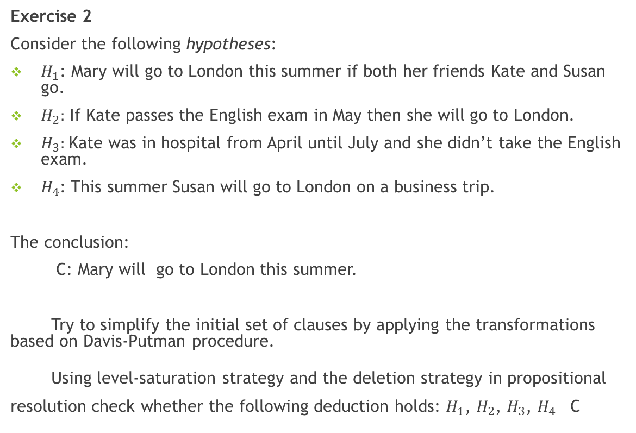
PROBLEM STATEMENT
Exercise 2
Consider the following hypotheses:
$H_{1}$: Mary will go to London this summer if both her friends Kate and Susan go.
$H_{2}:$ If Kate passes the English exam in May then she will go to London.
$H_{3}:$Kate was in hospital from April until July and she didn’t take the English exam.
$H_{4}$: This summer Susan will go to London on a business trip.
The conclusion:
C: Mary will go to London this summer.
Try to simplify the initial set of clauses by applying the transformations based on Davis-Putman procedure.
Using level-saturation strategy and the deletion strategy in propositional resolution check whether the following deduction holds: $H_{1}$, $H_{2}$, $H_{3}$, $H_{4}$ C

Slide 2
THEORETICAL DETAILS

Slide 3
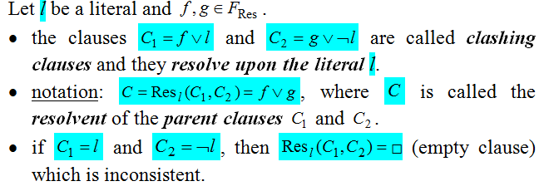
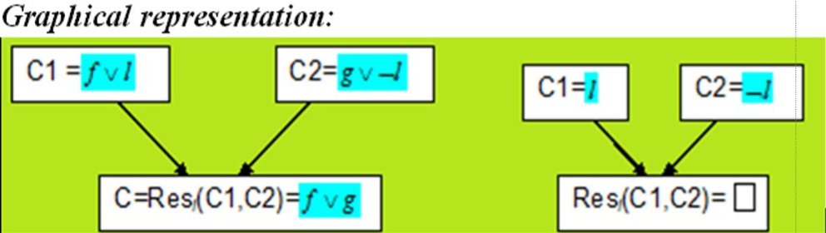
DEFINITIONS

Slide 4
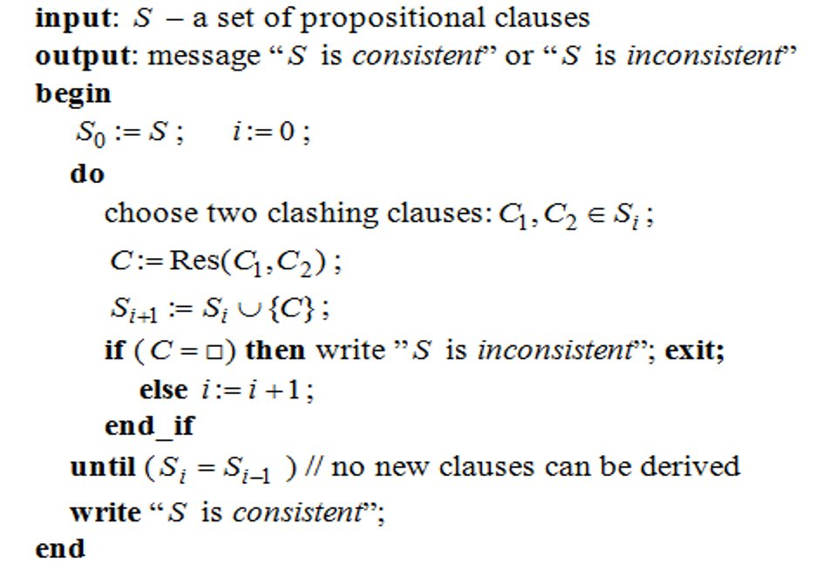
ALGORITHM FOR GENERAL PROPOSITIONAL RESOLUTION

Slide 5
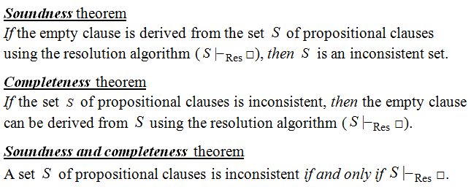
THEORETICAL RESULTS

Slide 6
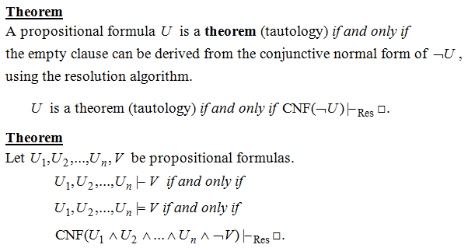
RESOLUTION ->a refutation proof method

Slide 7
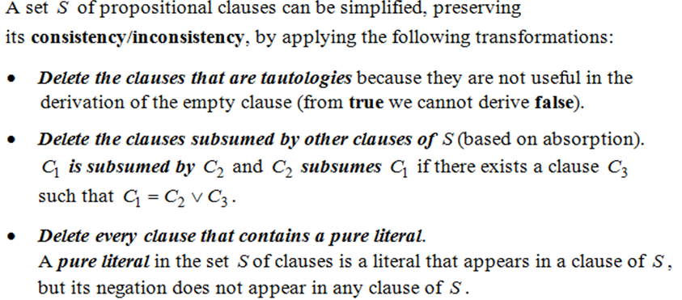
THEOREM BASED ON THE DAVIS-PUTMAN PROCEDURE

Slide 8
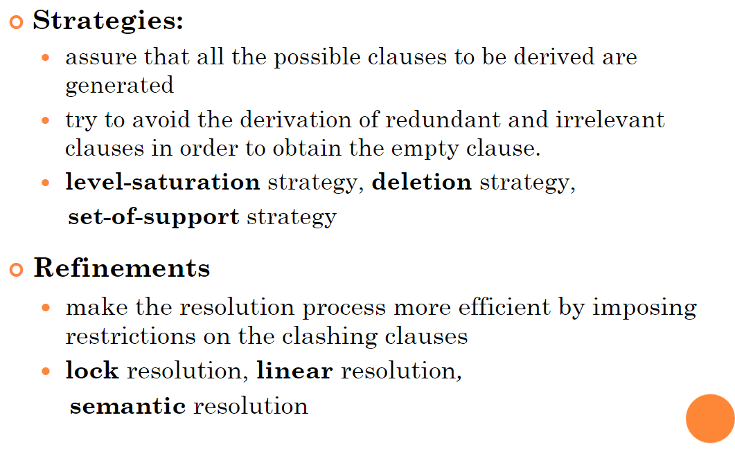
STRATEGIES AND REFINEMENTS OF RESOLUTION

Slide 9
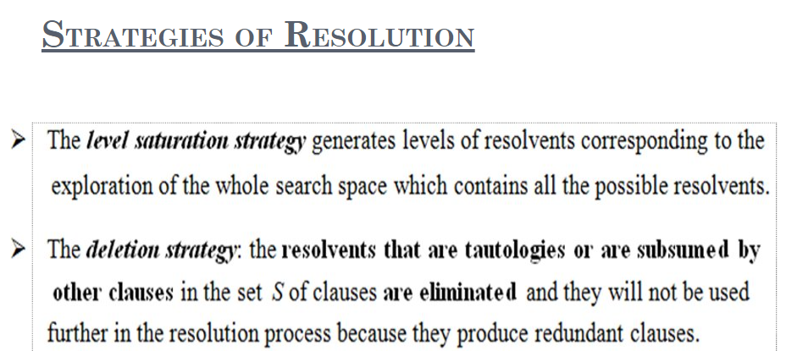

Slide 10
HOMEWORK SOLUTION

Slide 11
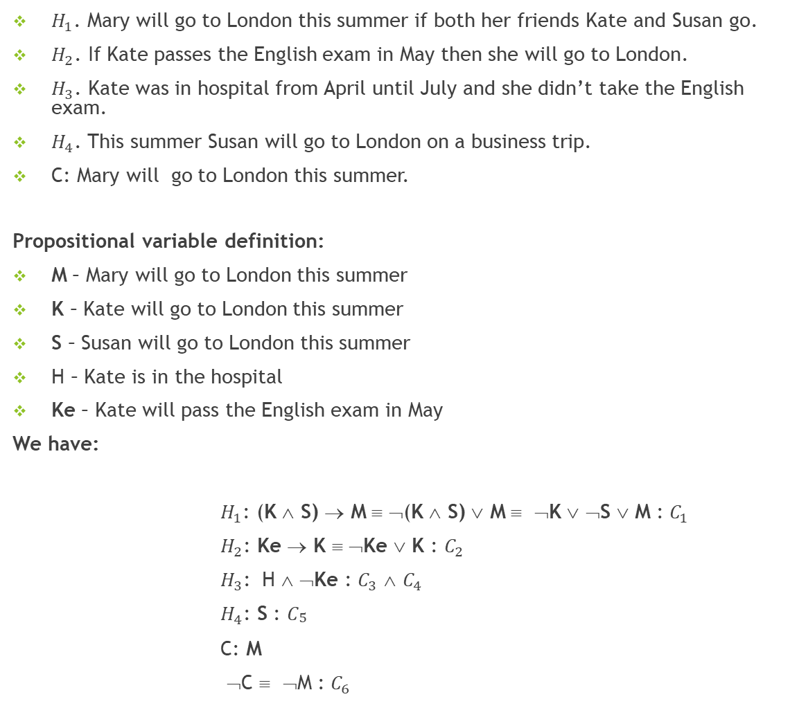
$H_{1}$. Mary will go to London this summer if both her friends Kate and Susan go.
$H_{2}$. If Kate passes the English exam in May then she will go to London.
$H_{3}$. Kate was in hospital from April until July and she didn’t take the English exam.
$H_{4}$. This summer Susan will go to London on a business trip.
C: Mary will go to London this summer.
Propositional variable definition:
M – Mary will go to London this summer
K – Kate will go to London this summer
S – Susan will go to London this summer
H – Kate is in the hospital
Ke – Kate will pass the English exam in May
We have:
$H_{1}$: (K ∧ S) → M ≡ ¬(K ∧ S) ∨ M ≡ ¬K ∨ ¬S ∨ M : $C_{1}$
$H_{2}$: Ke → K ≡ ¬Ke ∨ K : $C_{2}$
$H_{3}$: H ∧ ¬Ke : $C_{3}$ ∧ $C_{4}$
$H_{4}$: S : $C_{\begin{aligned}5 \\ \#\end{aligned}}$
C: M
¬C ≡ ¬M : $C_{6}$

Slide 12

THE DAVIS-PUTMAN PROCEDURE
X = {$C_{1}$. $C_{2}$, $C_{3}$, $C_{4}$, $C_{5}$, $C_{6}$} - CLAUSES
$C_{1}$= ≡ ¬K ∨ ¬S ∨ M
$C_{2}$ = ¬Ke ∨ K
$C_{3}$= H
$C_{4}$ = ¬Ke
$C_{5}$= S
$C_{6}$ = ¬M
We have the pure literals H and ¬Ke : we delete Clauses 2, 3 and 4
There are no tautologies amongst the clauses.
The set of remaining clauses is:
S = {$C_{1}$, $C_{5}$, $C_{6}$}

Slide 13
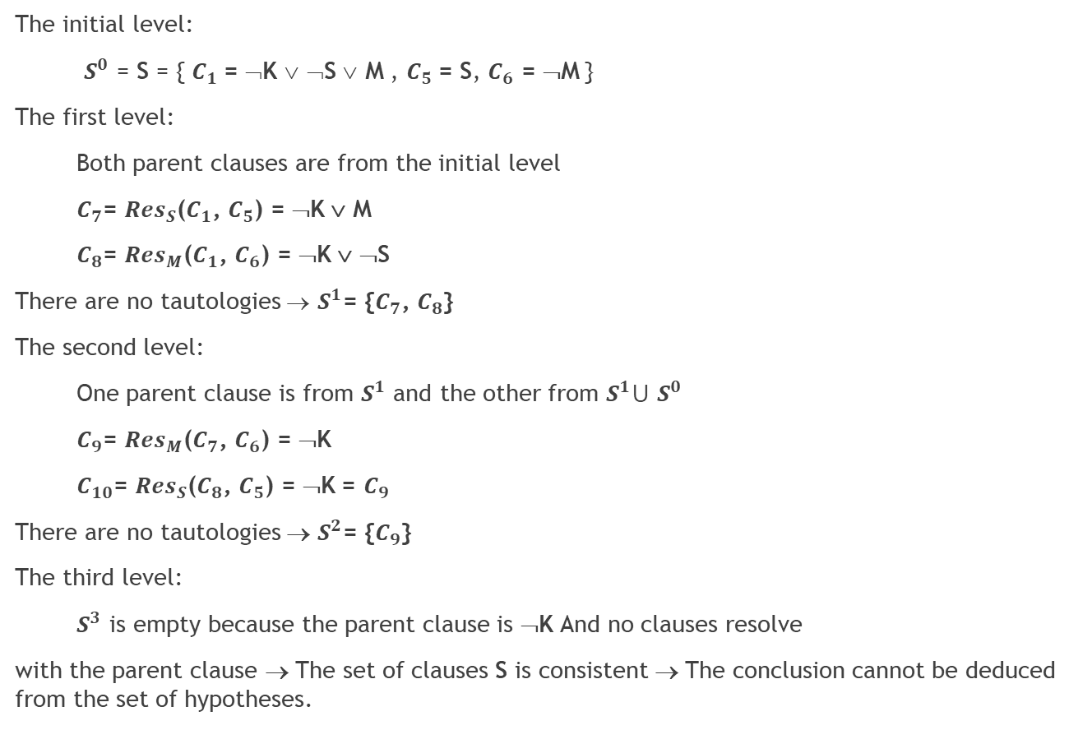
THE LEVEL SATURATION AND DELETION STRATEGY
The initial level:
$S^{0}$ = S = { $C_{1}$= ¬K ∨ ¬S ∨ M , $C_{5}$= S, $C_{6}$ = ¬M }
The first level:
Both parent clauses are from the initial level
$C_{7}$= ${Res}_{S}$($C_{1}$, $C_{5}$) = ¬K ∨ M
$C_{8}$= ${Res}_{M}$($C_{1}$, $C_{6}$) = ¬K ∨ ¬S
There are no tautologies → $S^{1}$= {$C_{7}$, $C_{8}$}
The second level:
One parent clause is from $S^{1}$ and the other from $S^{1}$⋃ $S^{0}$
$C_{9}$= ${Res}_{M}$($C_{7}$, $C_{6}$) = ¬K
$C_{10}$= ${Res}_{S}$($C_{8}$, $C_{5}$) = ¬K = $C_{9}$
There are no tautologies → $S^{2}$= {$C_{9}$}
The third level:
$S^{3}$ is empty because the parent clause is ¬K And no clauses resolve
with the parent clause → The set of clauses S is consistent → The conclusion cannot be deduced from the set of hypotheses.

